Slide 1
2021 Survey of Research Software Developers - Analysis
July 26, 2021

Slide 2
Survey Information
Date: April 12, 2021 – April 30, 2021
94 total respondents

Slide 3
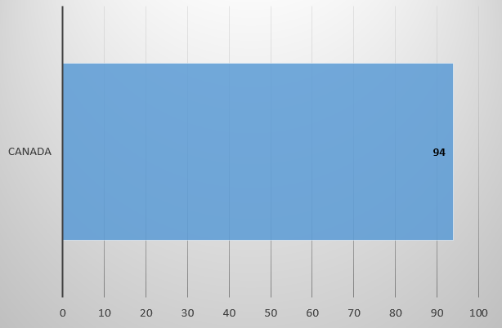
Q1. In which country do you work?

Slide 4
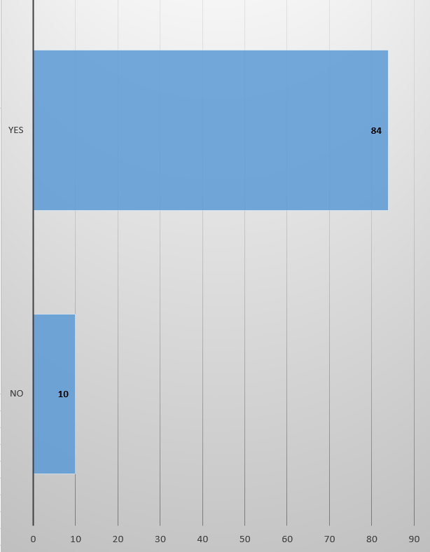
Q2. Do you write software for academic research as part of your job?

Slide 5
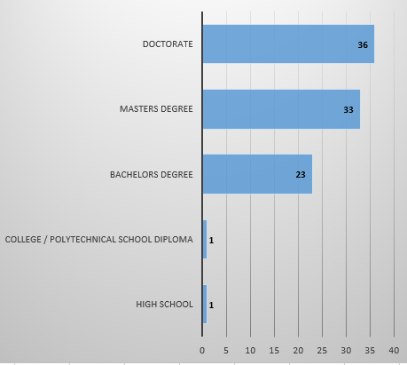
Q3. What is the highest level of education you’ve completed?

Slide 6
Q4. In which discipline is your highest academic qualification?
Top 5
Computer Science (35 responses)
Biological Sciences (14 responses)
Physics and Astronomy (11 responses)
Mathematics (5 responses)
Electrical and Electronic Engineering (4 responses)
Please see raw data for details
94 total responses

Slide 7
Q5. List any professional qualifications that you hold (e.g. P. Eng, PMP,…)
Top 2
PhD (3 responses)
PMP(2 responses)
Everything else has 1 response
Please see raw data for details

Slide 8
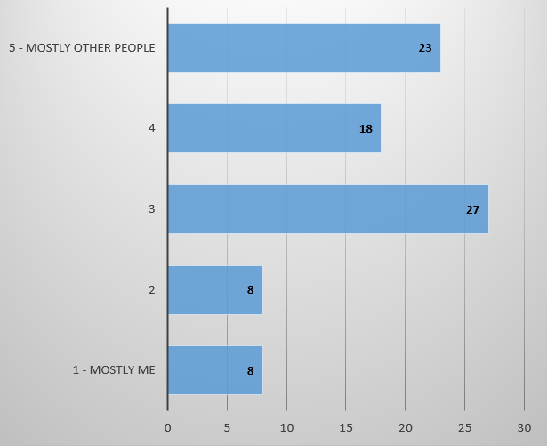
Q6. Who uses the code that you write?

Slide 9
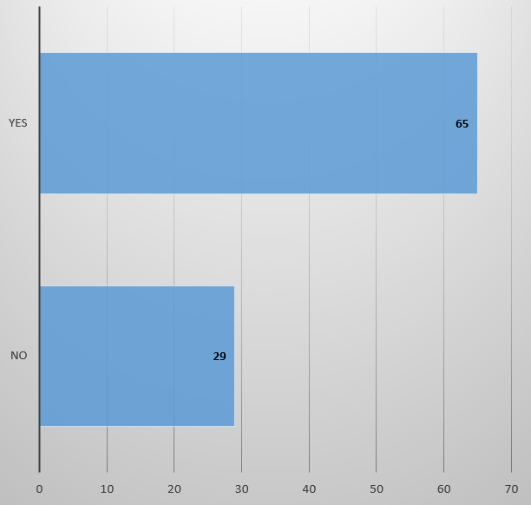
Q7. Do you consider yourself a professional software developer?

Slide 10
Q8. How many years of software development experience do you have?
Top 5
20 years (16 responses)
15 years (10 responses)
5 years (7 responses)
2 years (6 responses)
12 years (5 responses)
Please see raw data for details
94 total responses

Slide 11
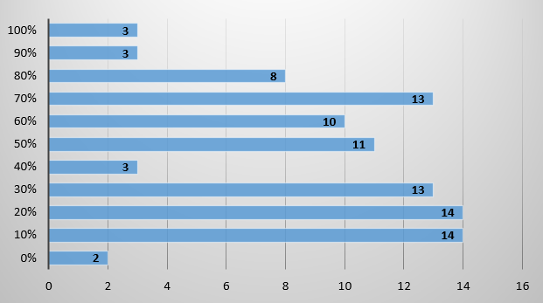
Q9. On average, what percentage of your time is spent developing software?

Slide 12
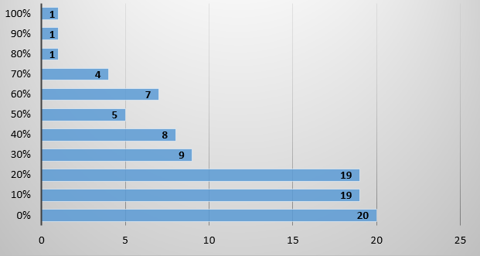
Q10. On average, what percentage of your time is spent on research?

Slide 13
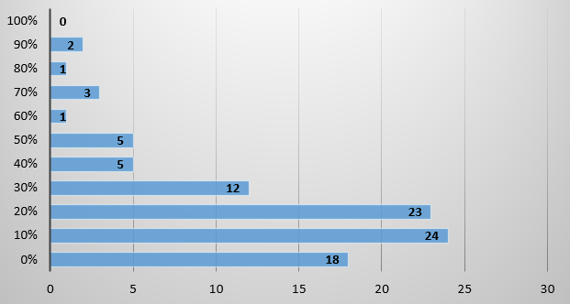
Q11. On average, what percentage of time is spent on management?

Slide 14
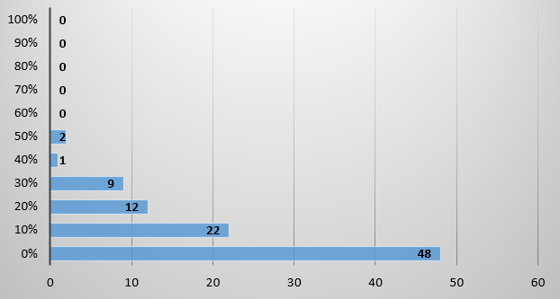
Q12. On average, what percentage of your time is spent teaching?

Slide 15
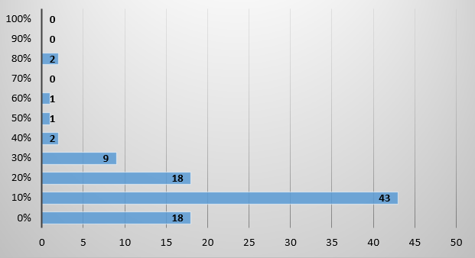
Q13. On average, what percentage of time is spent on other activities?

Slide 16
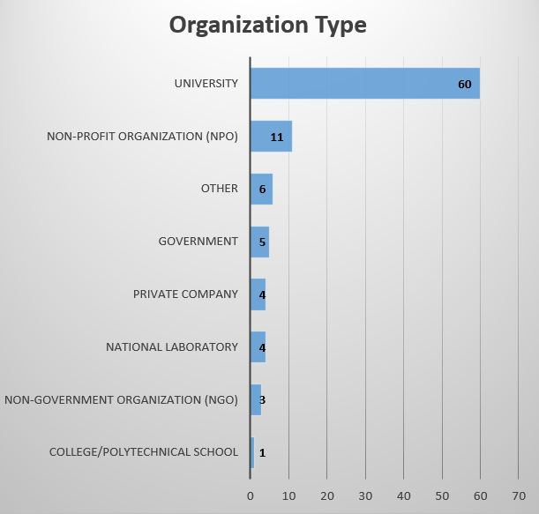
Q14. Please select your organization type
7/8 Other responses were for Research Hospitals. Self-employed was the single other response.

Slide 17
Q15. What is your job title?
Top 5
Software Developer (6 responses)
Research Software Developer (4 responses)
Research Associate (3 responses)
Assistant Professor (3 responses)
Research Programmer (2 responses)
Please see raw data for details
94 total responses

Slide 18
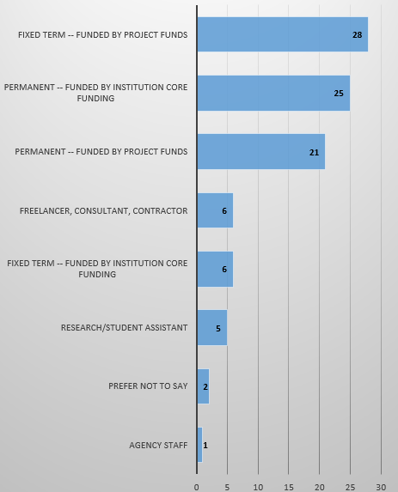
Q16. What is the nature of your employment?

Slide 19
Q17. Please select discipline(s) in which you work. Please select all that apply.
Top 5
Biological Sciences (49 responses)
Computer Science (48 responses)
Physics and Astronomy (26 responses)
Medicine (21 responses)
Mathematics (12 responses)
Please see raw data for details
94 total responses

Slide 20
Q18. How is your current research software work funded? Please select all that apply.
Top 5
CANARIE (25 responses)
CFI (15 responses)
Employer (13 responses)
Other (13 responses)
NSERC (11 responses)
Please see raw data for details
94 total responses

Slide 21
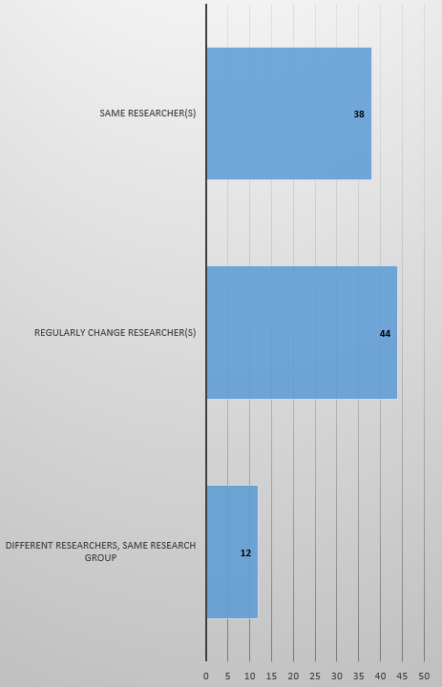
Q19. Do you always work with the same researcher(s) or do you regularly change the researcher(s) you work with?

Slide 22
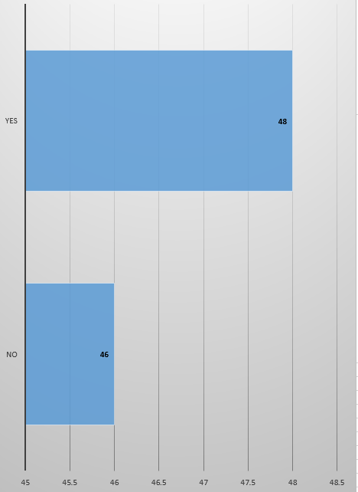
Q20. Are you part of a dedicated research software group within your organization?

Slide 23
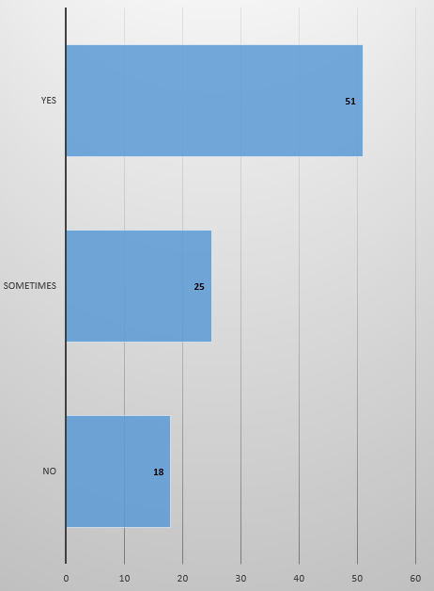
Q21. In general, when your software contributes to a paper, are you acknowledged in the paper?

Slide 24
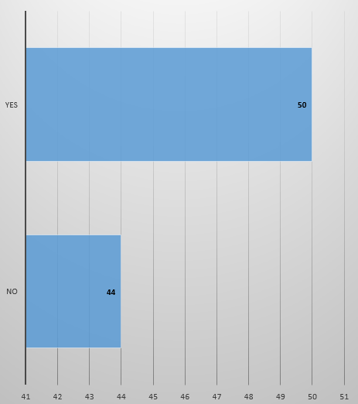
Q22. Have you ever presented your software works at a conference or workshop?

Slide 25
Q23. If you answered “yes” to the above question, at which conference(s)/workshop(s) have you presented your software work?
Please see raw data for details
94 total responses

Slide 26
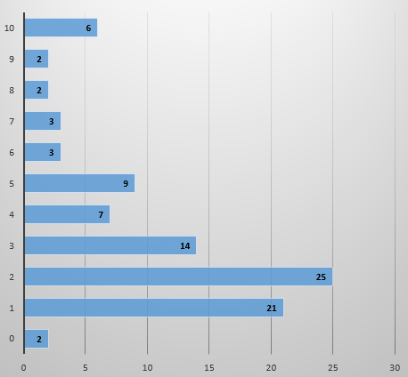
Q24. How many software projects are you currently involved in?

Slide 27
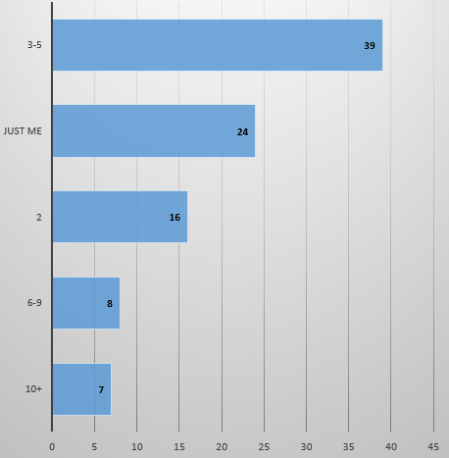
Q25. How many software developers typically work on your projects?

Slide 28
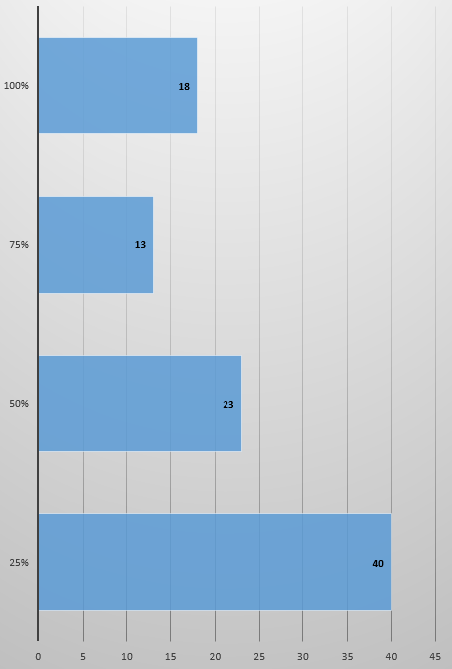
Q26. Thinking about the question above, what percentage of developers are dedicated to the project full-time?

Slide 29
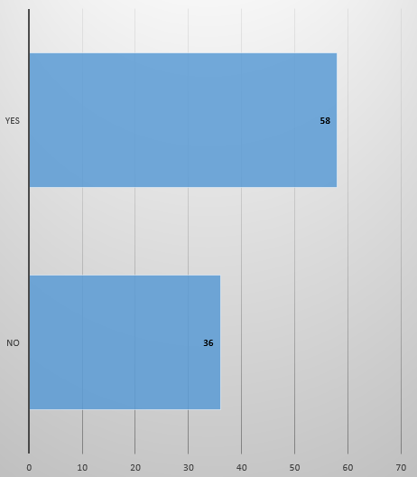
Q27. Do your research software projects typically include a project manager?

Slide 30
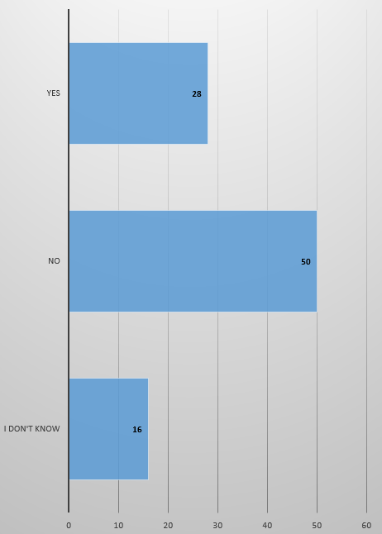
Q28. Do the projects you work on typically have a contingency plan for if/when developers leave the group?

Slide 31
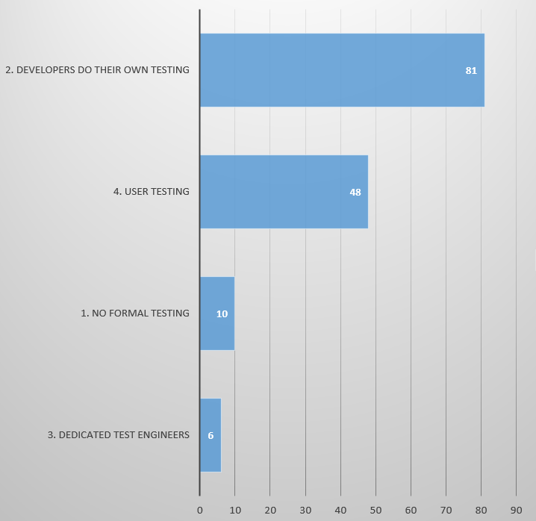
Q29. How are your projects typically tested? Please check all that apply.

Slide 32
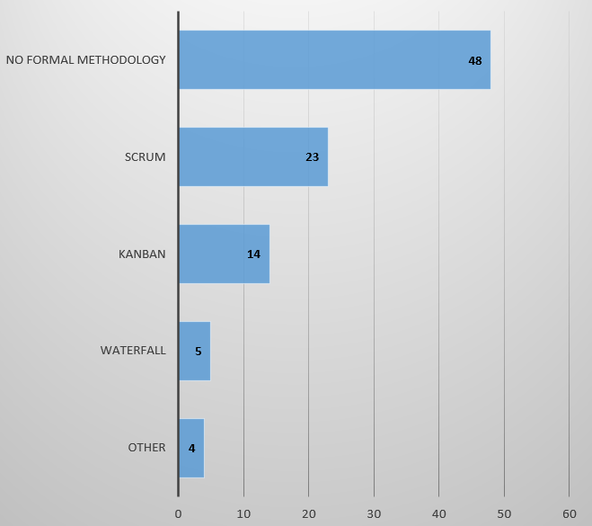
Q30. What development methodology does your current project use? Please select the one that most closely applies.

Slide 33
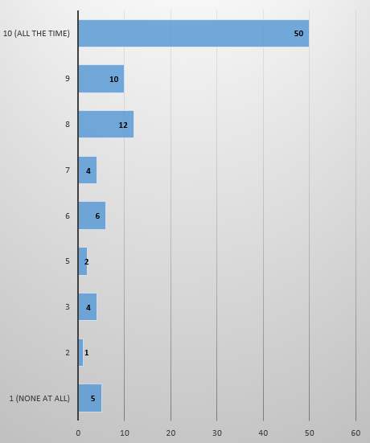
Q31. How often do you use an open-source license for your software?

Slide 34
Q32. Which tools do you use to mint a digital object identifier (DOI)?
Top 4
None / N/A (38 responses)
Zenodo (7 responses)
None (2)
Unsure (2)
Please see raw data for details
94 total responses

Slide 35
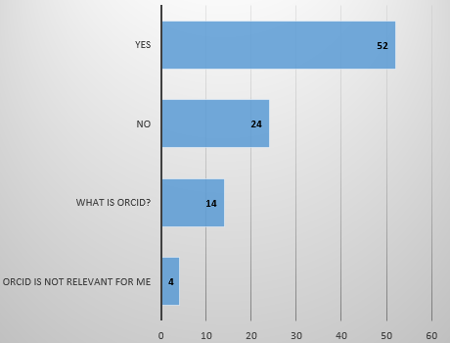
Q33. Do you have an ORCID ID?

Slide 36
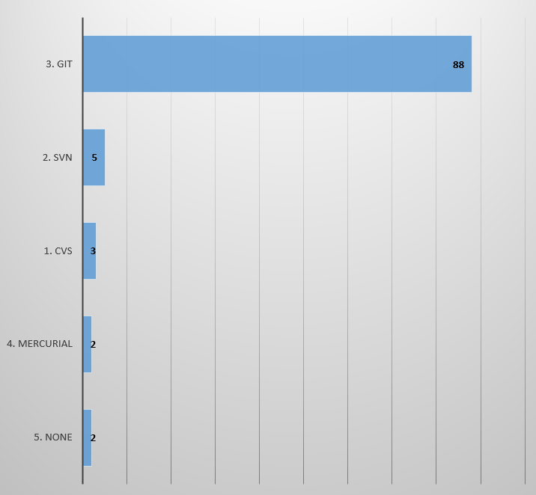
Q34. Which version control tools do you use for software development?

Slide 37
Q35. Which online collaboration tools and open repositories do you use for software development?
Top 4
Github (23 responses)
Git (6 responses)
Gitlab (4 responses)
Slack (2)
Please see raw data for details
94 total responses

Slide 38
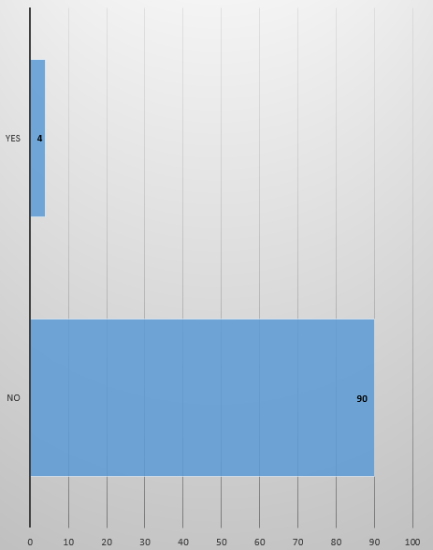
Q36. Are you a member of an associated of Research Software Developers (e.g. UK RSE)

Slide 39
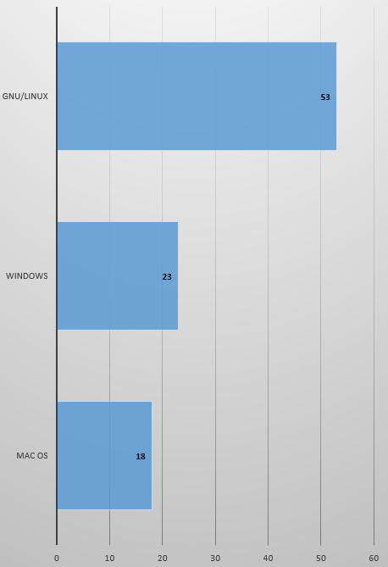
Q37. Which operating system do you primarily use for development? Please select the one that most closely applies.

Slide 40
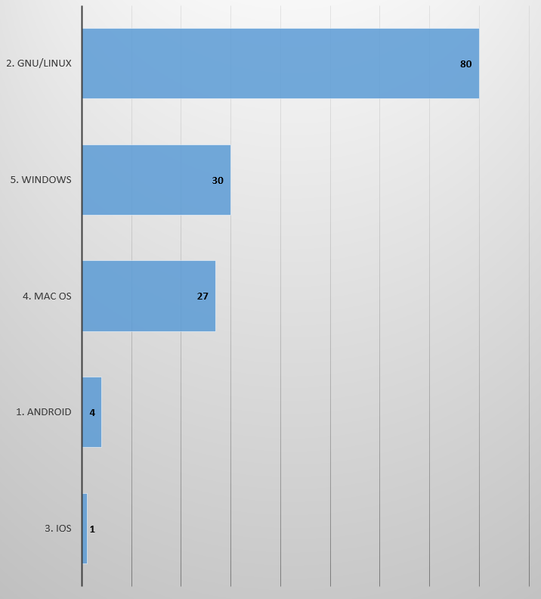
Q38. Which operating system do you primarily use for deployment? Please check all that apply.

Slide 41
Q39. What programming language do you use at work? Please select all that apply.
Top 5
Python (77 responses)
Javascript (44 responses)
SQL (38 responses)
R (33 responses)
C++ (30 responses)
Please see raw data for details
94 total responses

Slide 42
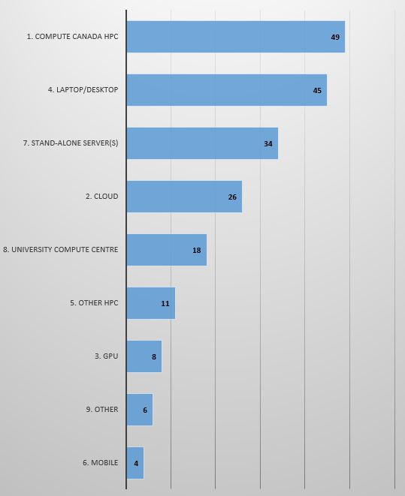
Q40. On which platform(s) is your most recent research software project deployed? Please select all that apply.

Slide 43
Q41. How did you learn the required skills to become a Research Software Engineer / Research Software Developer?
Top 3
Self-Taught (6 responses)
University (4 responses)
On the job (3 responses)
Please see raw data for details
94 total responses

Slide 44
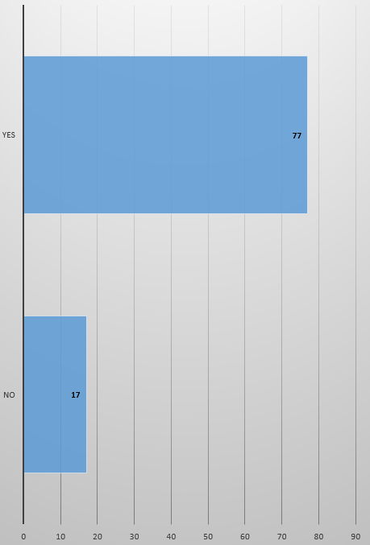
Q42. Are you interested in attending a conference about software development in academia?

Slide 45
Q43. What three skills would you like to acquire or improve to help your work as a research software engineer / research software developer? These skills can be technical and non-technical.
Please see raw data for details
94 total responses

